Slide 1
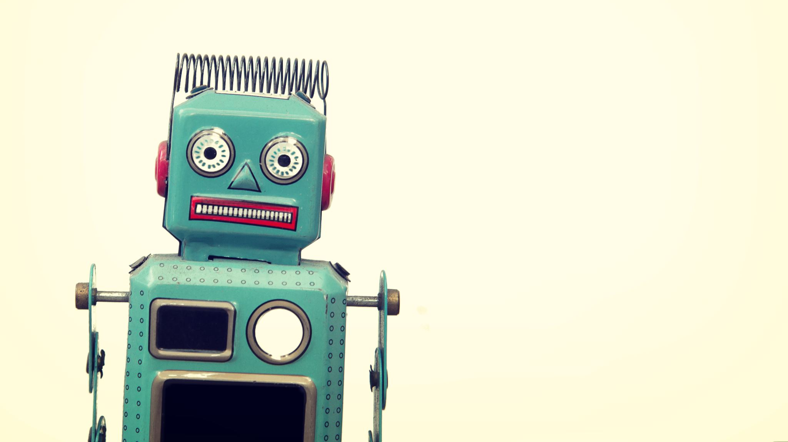
personal quick chat bot
A system which talk on behalf of the user

Slide 2
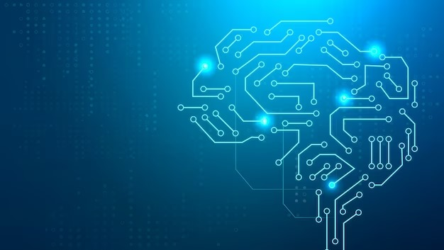
Problem definition
In todays generation the people are becoming introvert
Introvert--people are scared to be socialized aur get connected with other and only Comfortable in focusing in there inner thoughts and ideas rather than what happening externally.
sometimes you are too busy to talk to people and scared that you will lose bond with your loved ones .
When you are not in mood of talking to the person and he sending text to you

Slide 3
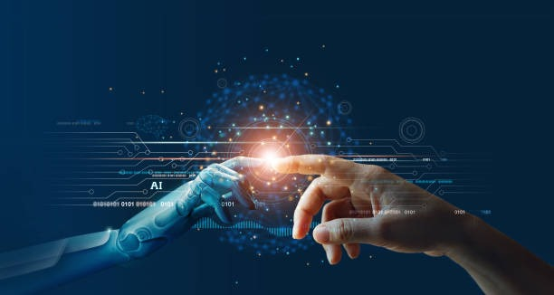
Solution
It allow introvert person to socialized with other on social medias or any chatting or texting platform .
Sometimes you are too busy and don’t have time to talk to each and every person which is connected to you through texting or chatting you can use this bot as a alternative to save your time while you are busy in working or any thing .
When your very close friend wants to talk to you but you busy in studying or any other important work. You can access the bot and it chat in behalf of your self on the basis you old conversation .
Sometimes you don’t have any topic or stuck what to reply to the person this bot will help you find topic and help you to reply with creative manner .
Bot provide more specific points in the conversation it can be used in corporate fields to have formal and elegante conversation.

Slide 4
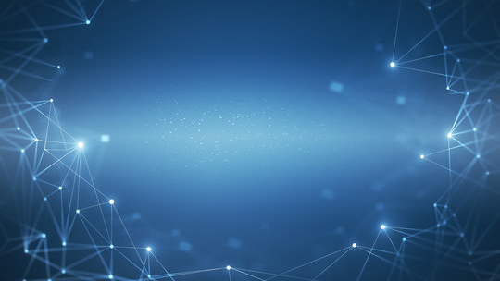
Techstack
C++: C++ is a high-performance language commonly used in AI for tasks that require speed and efficiency, such as computer vision and robotics. Libraries like OpenCV and Dlib are popular choices for C++ AI development.
As it is basic language for programming and as per the limit of our knowledge we only know how to code in c++.
Chatbot Logic : Implement the core logic of your chatbot in C++.Use data structures and algorithms for handling user queries and generating responses.
Data Storage : If your chatbot needs to store and retrieve data, you can use C++ database
User Interaction : For user interaction and input/output handling, you can use standard C++ input/output streams

Slide 5
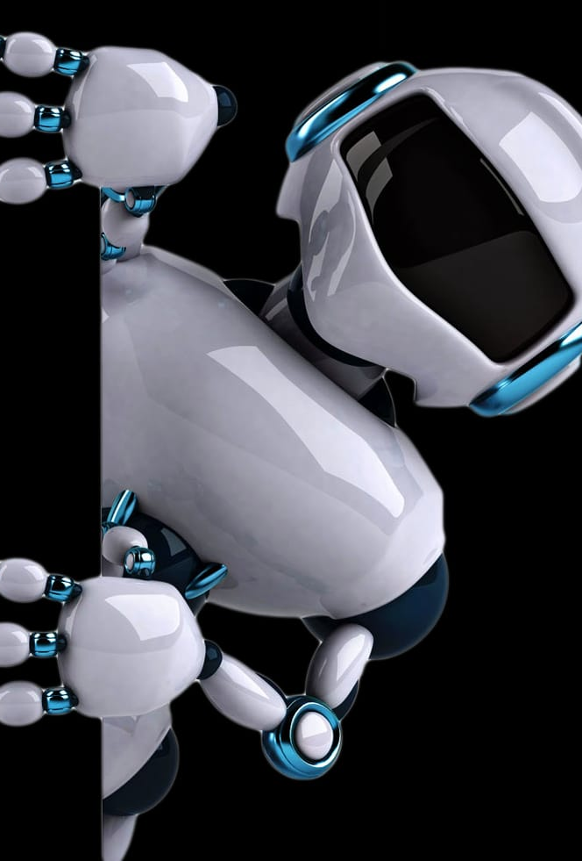
Uniqueness of our bot from other
Our bot recognize the pattern of old conversation of the user and reply on the basis the old chats .
It recognize the mood second person and create text on basis of the mood the second person .
It will get activated on command of the user and read the behaviour and mood of user .
It will be available to user 24/7 .
It can take handle many situation simultaneousl.

Slide 6
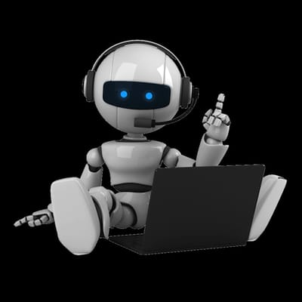

Architecture of our idea
`
Programming
Chat bot
The reciver and bot is talking
The user is busy

Slide 7
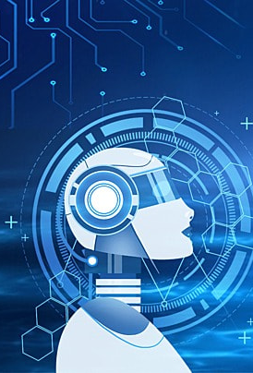
Conclusion
The chat bot revolution is here to stay, and it's changing the way we interact with technology. With their ability to understand natural language and provide quick and efficient service, chat bots are becoming an integral part of our daily lives. So next time you need a personal assistant, just say hello to your friendly neighborhood chat bot!

